Slide 1
PEOPLE’S COMMITTEE OF DISTRICT 3 DEPARTMENT OF EDUCATION AND TRAINING

Slide 2
PEOPLE’S COMMITTEE OF DISTRICT 3 NGUYỄN THI PRIMARY SCHOOL
SUBJECT: ENGLISH
Teacher:Võ Thị Mỹ Phượng
It’s nice to meet you.
District 3, September 22th , 2021.

Slide 4
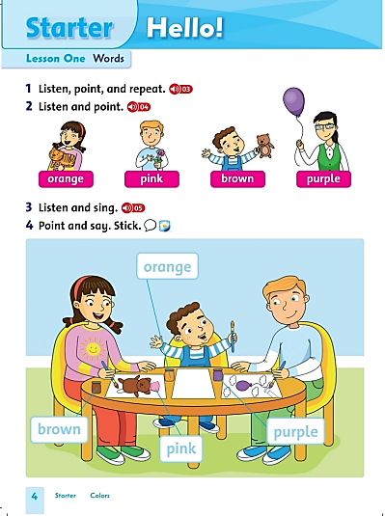
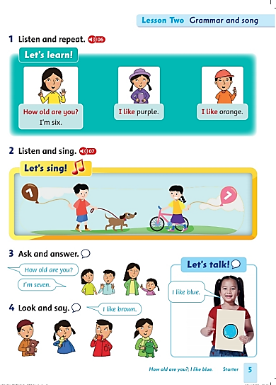

Slide 5
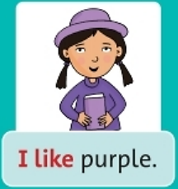
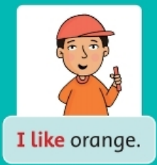
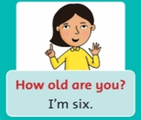
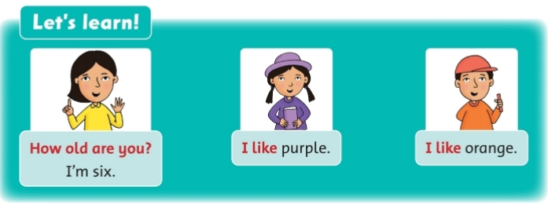
Listen and repeat
Listen

Slide 6
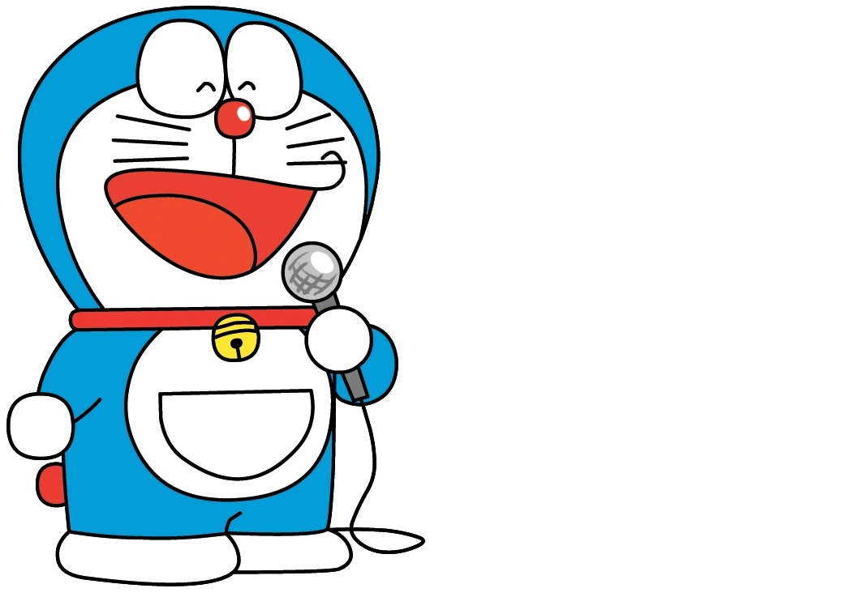
Speaking
What’s your name?
My name is…………
How old are you ?
I’m ………….
What’s your favorite color?
It’s ………….

Slide 7
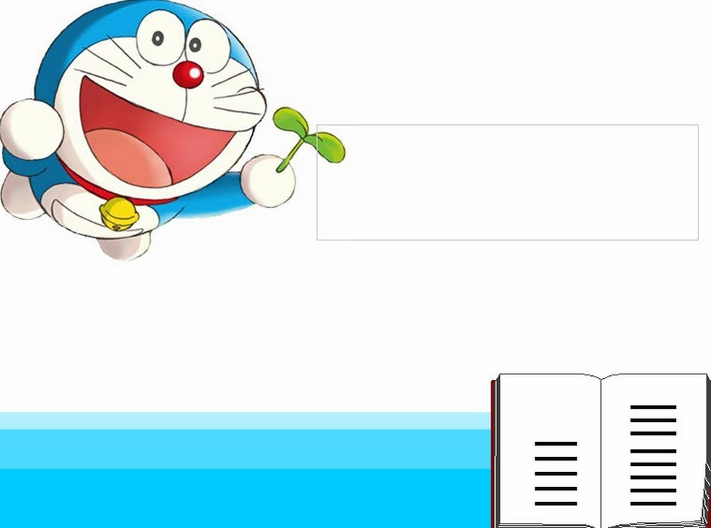
Workbook page 4,5

Slide 8
March

Slide 9
Say the word.
Circle the correct picture.
3.orange
4. purple

Slide 10
Say the word.
Circle the correct picture.
3. brown
4. pink

Slide 11
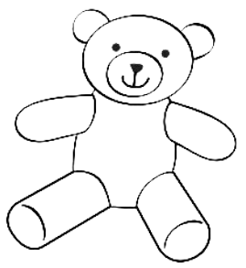
Read and color.
brown

Slide 12
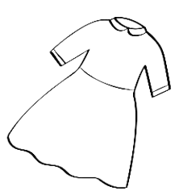
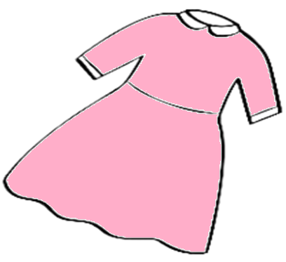
Read and color.
pink

Slide 13
Read and color.
orange

Slide 14
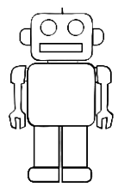
Read and color.
purple

Slide 15
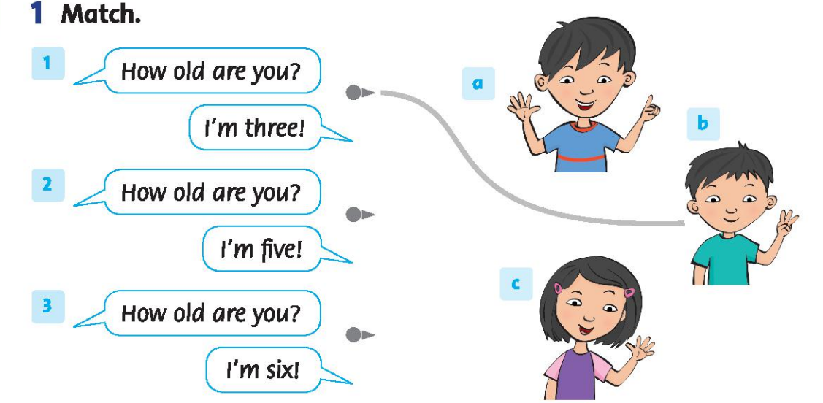
1 page 5

Slide 16
Stick in the box, please!
Very satisfied
Satisfied
Not satisfied

Slide 17
PEOPLE’S COMMITTEE OF DISTRICT 3 NGUYỄN THI PRIMARY SCHOOL
Thanks for your watching.
Teacher:Võ Thị Mỹ Phượng
Nguyễn Thi primary school’s website
https://thnguyenthiq3.hcm.edu.vn

